Slide 1
Information Extraction

Slide 2
What is knowledge acquisition?
Knowledge acquisition: process to extract knowledge (to be integrated into knowledge bases) from unstructured text or other data
Raw Text
(HTML pages, etc)
Refined Text
Textual Entities and Relations
Knowledge Bases
Information Extraction (only entities)

Slide 3
Information Extraction
Two types of information extraction
Named Entity Recognition (NER)
Relation Extraction (RE)
Sometimes NER is seen as a sort of NLP pre-processing
Sometimes in literature the task of relation extraction is referred to as information extraction. We keep the distinction between NER and RE

Slide 4
Rough Accuracy of Information Extraction
Information type | Accuracy
Entities | 90-98%
Attributes | 80%
Relations | 60-70%
Events | 50-60%
These are very rough, actually optimistic, numbers
Hold for well-established tasks, but lower for many specific/novel IE tasks
Table from http://web.stanford.edu/class/cs124

Slide 5
Named Entity Recognition (intro)
Slides inspired by http://web.stanford.edu/class/cs124/

Slide 6
Named Entity Recognition (NER)
Named entities: Anything you can refer with a name to with a name
Locations, persons, organizations
Facilities, vehicles, songs, movies, products
Etc.
Named entity Recognition: find and classify names in text, for example:
“The decision by the independent MP Andrew Wilkie to withdraw his support for the minority
Labor government sounded dramatic but it should not further threaten its stability. When,
after the 2010 election, Wilkie, Rob Oakeshott, Tony Windsor and the Greens agreed to support
Labor, they gave just two guarantees: confidence and supply.”

Slide 7
Named Entity Recognition (NER)
Named entities: Anything you can refer with a name to with a name
Locations, persons, organizations
Facilities, vehicles, songs, movies, products
Etc.
Named entity Recognition: find and classify names in text, for example:
“The decision by the independent MP Andrew Wilkie to withdraw his support for the minority
Labor government sounded dramatic but it should not further threaten its stability. When,
after the 2010 election, Wilkie, Rob Oakeshott, Tony Windsor and the Greens agreed to support
Labor, they gave just two guarantees: confidence and supply.”

Slide 8
Named Entity Recognition (NER)
Named entities: Anything you can refer with a name to with a name
Locations, persons, organizations
Facilities, vehicles, songs, movies, products
Etc.
Named entity Recognition: find and classify names in text, for example:
Person
Date
Location
Organi-
zation
“The decision by the independent MP Andrew Wilkie to withdraw his support for the minority
Labor government sounded dramatic but it should not further threaten its stability. When,
after the 2010 election, Wilkie, Rob Oakeshott, Tony Windsor and the Greens agreed to support
Labor, they gave just two guarantees: confidence and supply.”

Slide 9
Named Entity Recognition (NER)
Detecting entities is useful because
Named entities can be indexed, linked off, etc.
Sentiment can be attributed to companies or products
A lot of relations are associations between named entities
For question answering, answers are often named entities
Concretely
Many web pages tag various entities, with links to bio or topic pages, etc.
Reuters’ OpenCalais, Evri, AlchemyAPI, Yahoo’s Term Extraction, …
Apple/Google/Microsoft/… smart recognizers for document content

Slide 10
Named Entity Recognition (NER)
Like POS, also NER is sequence labeling problem
Three standard approaches
Hand-written regular expressions
Using classifiers
Generative: Naïve Bayes
Discriminative: Max entropy models
Sequence models
Hidden Markov Models
CMMs (Conditional Markov Models) /MEMMs (Maximum Entropy Models)
CRFs (Conditional Random Fields)

Slide 11
Named Entity Recognition (NER)
Typically state-of-the-art Named Entity Recognizers can detect only gross-grained types of entities (e.g. Persons, Locations, Organizations)
Some of the most popular ones
Stanford’s NER (http://nlp.stanford.edu/software/CRF-NER.shtml) [1]
Uses a conditional random fields model
Apache OpenNLP (https://opennlp.apache.org/)
Uses a maximum entropy model
MALLET (http://mallet.cs.umass.edu/)
Uses a conditional random fields model
[1] J. R. Finkel, T. Grenager, and C. Manning, “Incorporating Non-local Information into Information Extraction Systems by Gibbs Sampling,” in ACL, 2005, pp. 363–370.

Slide 12
Entity Linking

Slide 13
What is knowledge acquisition?
Knowledge acquisition: process to extract knowledge (to be integrated into knowledge bases) from unstructured text or other data
Raw Text
(HTML pages, etc)
Refined Text
Textual Entities and Relations
Knowledge Bases
Linking mentions

Slide 14
Problem

Slide 15
Problem

Slide 16
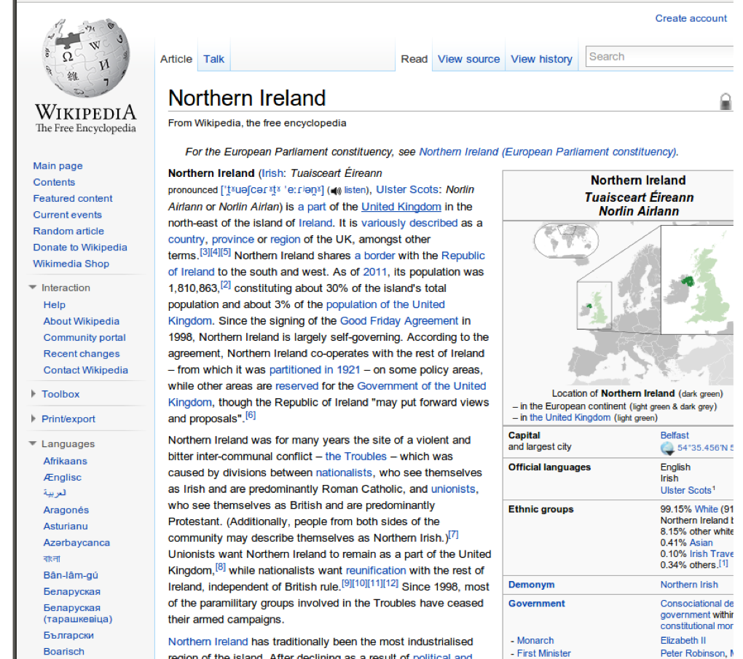
Problem

Slide 17
Problem

Slide 18
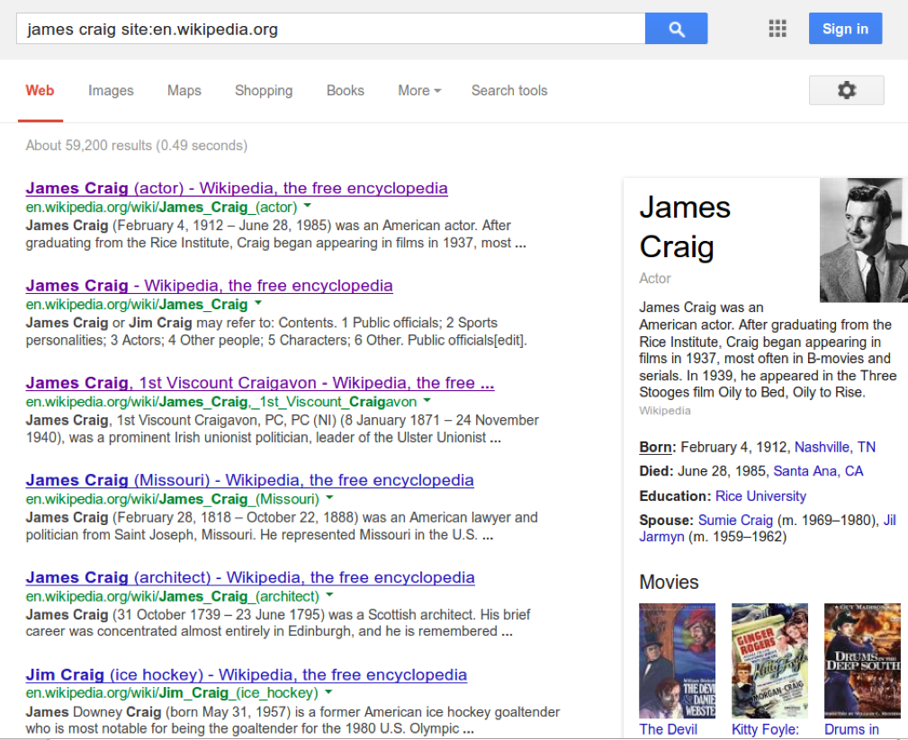
Problem

Slide 19
Different types of linking
Table from M. Cornolti, P. Ferragina, and M. Ciaramita, “A framework for benchmarking entity-annotation systems,” in WWW, 2013, pp. 249–260.

Slide 20
Goal of Entity Linking

Slide 21
Entity Linking: Main Steps
Task: find one mapping from entity mentions in the text to entities in the Knowledge Base (KB)
Entity Linking consists of three main operations:
Candidate Entity Generation
Candidate Entity Ranking
Unlinkable Mention Prediction

Slide 22
Candidate Entity Generation

Slide 23
Candidate Entity Generation
Goal: Link any entity mention to a set of candidates entities in the knowledge base
Recall is important => If we miss some links, than we will never be able to recover
Three main techniques:
Dictionary-based techniques
Surface form expansion
Based on search-engines

Slide 24
Candidate Entity Generation
Dictionary-based techniques
The main idea is to construct an offline dictionary D between various names and the potential entities in the knowledge base
Wikipedia is the most popular source to construct such vocabulary, so that methods that use it are sometimes referred to as “Wikipedia-based methods”
Entity pages
Redirect pages
Disambiguation pages
Bold phrases
Hyperlinks

Slide 25
Candidate Entity Generation
Dictionary-based techniques
Wikipedia entity pages are pages that describe an entity
The title is typically the name of the entity

Slide 26
Candidate Entity Generation
Dictionary-based techniques
Redirect pages exists for each alternative name for the same identity

Slide 27
Candidate Entity Generation
Dictionary-based techniques
Disambiguation pages are used when the same name refer to different entities

Slide 28
Candidate Entity Generation
Dictionary-based techniques
Bold phrases from the first paragraphs often refers to other names of the same entity

Slide 29
Candidate Entity Generation
Dictionary-based techniques
Hyperlinks in Wikipedia articles contain anchor text that can be used as synonyms for a particular entity

Slide 30
Candidate Entity Generation
Dictionary-based techniques
Entities mentions in text can be matched with the dictionary keys either using exact matching or with other string similarity measures
Dice score (# common bigrams)
Hamming distance (minimum number of substitutions to convert strings)
Etc.
Sometimes entities are misspelled! There are algorithms to correct such cases

Slide 31
Candidate Entity Generation
Surface form expansion
Some entity mentions are acronyms or part of the entities’ full names
We can use surface form expansion techniques to identity the real names
Heuristic-based methods
Supervised learning methods

Slide 32
Candidate Entity Generation
Surface form expansion – Heuristic-based methods
We can search the text around the entity mention using pattern matching
University of Illinois at Urbana-Champaign (UIUC), HP (Hewlett-Packard)
We can check for N continuous words (without stop words) that have the same initials than the acronym
Michael I. Jordan => if “person” according to NER, then also “Jordan” refers to it

Slide 33
Candidate Entity Generation
Surface form expansion – Supervised Learning Methods
Some acronyms are quite hard for heuristic based methods
E.g. DOD=Department of Defense
We can use the extractions obtained with heuristics for training a supervised classifier (e.g. SVM). In literature the usage of such classifier improved the accuracy of 15.1% [1]
[1] W. Zhang, Y. C. Sim, J. Su, and C. L. Tan, “Entity Linking with Effective Acronym Expansion, Instance Selection, and Topic Modeling.,” in IJCAI, 2011, vol. 2011, pp. 1909–1914.

Slide 34
Candidate Entity Generation
Based on search engines
One simple idea is to query Google with the entity mention and check whether Wikipedia pages show up in the top-k positions
Disadvantage: this method does not scale!

